Slide 1
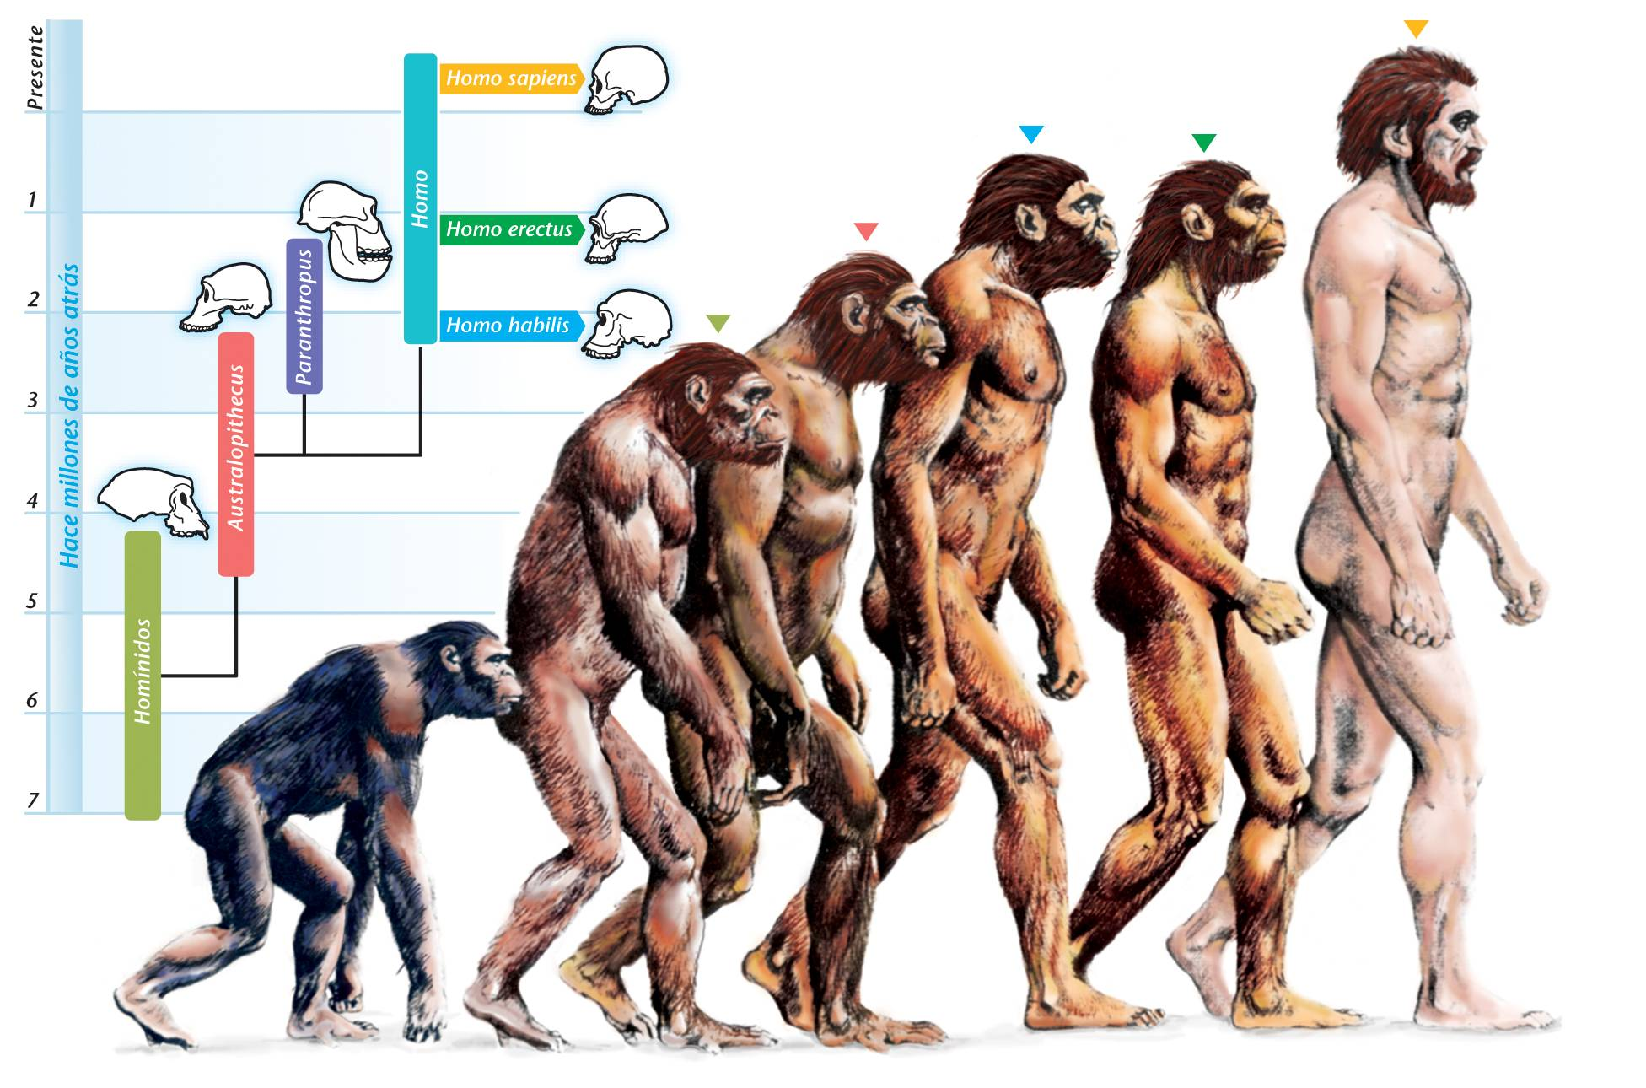
STAGES OF HUMAN EVOLUTION

Slide 2
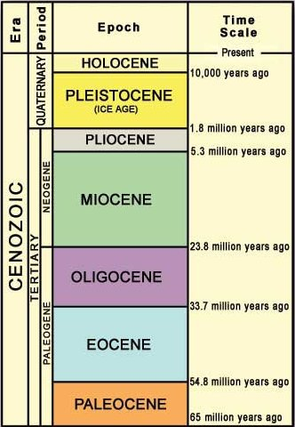
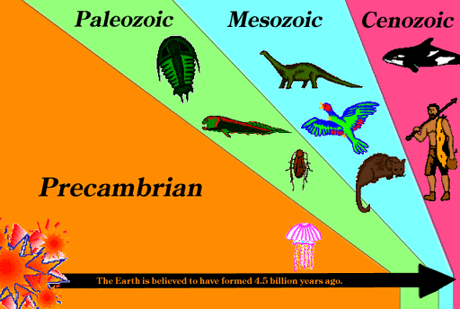
INTRODUCTION
Evolution is a gradual process in which something changes into a different and usually more complex or better form.
Biological evolution is defined as organisms reproducing but experiencing changes with each generation. Evolution can happen in a small and large context. There are small genetic changes between generations, as well as large changes that happen over multiple generations.
The actual story of human evolution has been starts from the Cenozoic Era (Tertiary Period) of the geological time scale. Because Cenozoic Era known as the ‘Age of Mammals’.

Slide 3
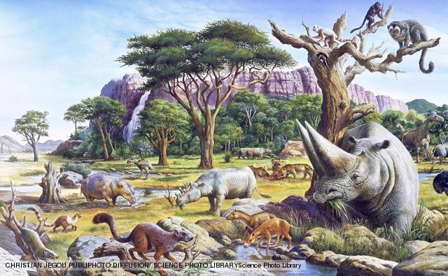
Cenozoic Era: The Age of Mammals

Slide 4
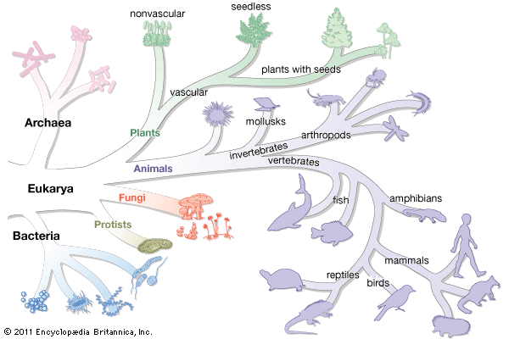
At the beginning of the tertiary period, a group of mammals splitted up into different major lines and primate arose.
Primate

Slide 5
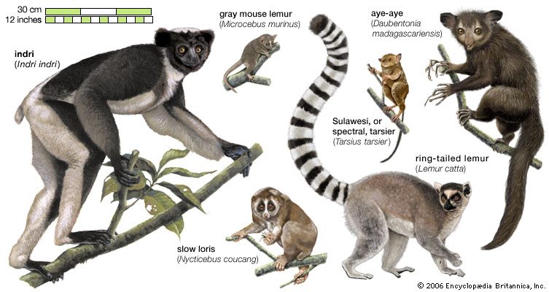
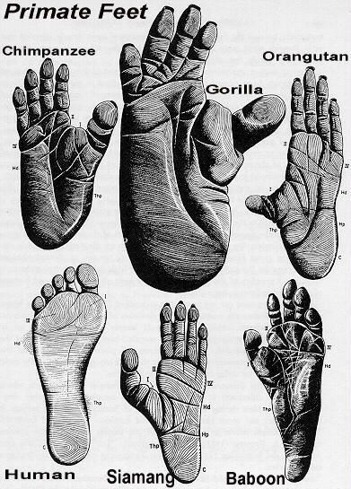
The earliest primates first exhibit the grasping paws where nails developed instead of claws. Five well-separated fingers on toes gave them the ability to rotate the great toe so as to oppose the other digits.

Slide 6
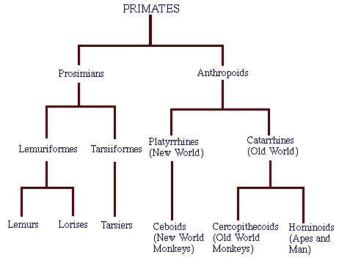
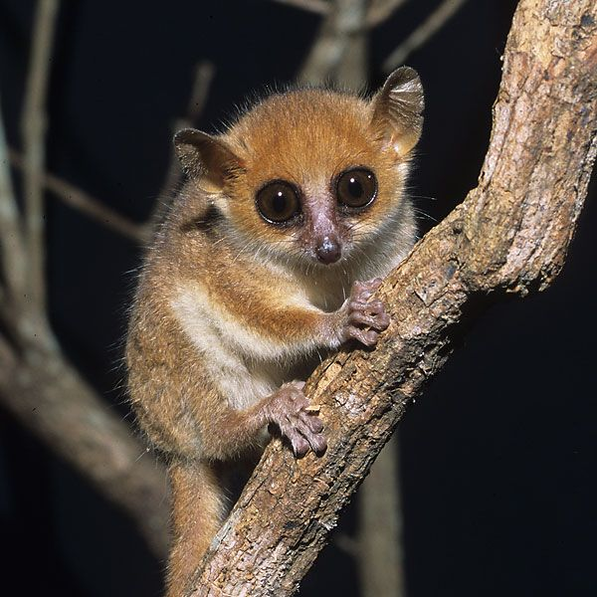
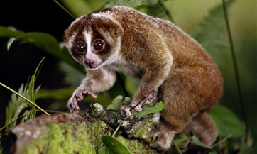
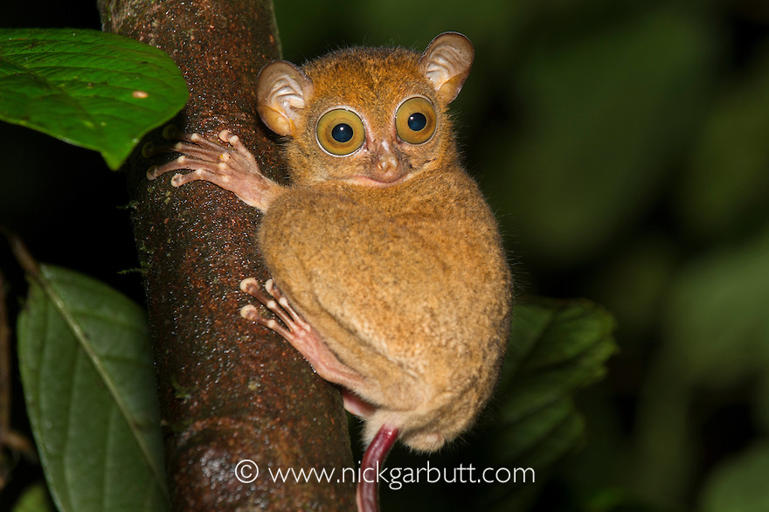
Primates of Paleocene splitted up into various prosimians lines and as a result plenty of small primates emerged out during Eocene epoch. Eocene is therefore called the ‘golden age of the prosimians’ most of them adapted an arboreal life, but some of them also lived in ground like squirrel and rodents.

Slide 7
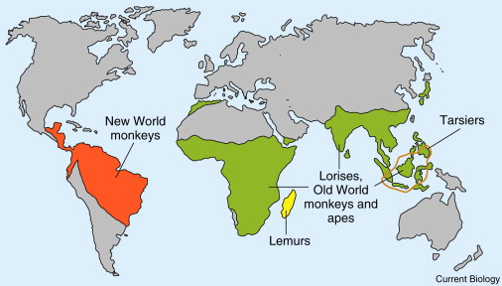
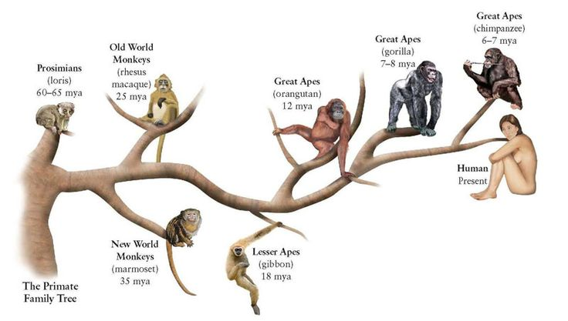
Small ancient prosimians are found to flourish all over the world especially North America, Europe, Africa and Asia during Eocene epoch. These early primate potentialities not only gave rise to the lemurs, lorises and tarsiers of present day but they also yielded true monkeys like Platyrrhine (broad-nosed/ sideward nose) and Catarrhine (downward-nose).

Slide 8
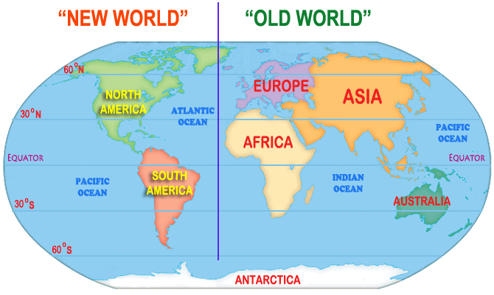
As the two hemispheres were isolated during Eocene, no primate could move from the new world to the old world or vice-versa. As a consequence, two strains developed side by side, parallel to each other.
In South America, new world monkeys such as marmoset, spider monkey, howler monkey, cebus etc. from a group (Platyrrhine) who could swing on their tails.
The second group of monkeys (Catarrhine) developed independently in the old world.

Slide 9
In the new world, the primate evolution could not go beyond the monkey stage. As the small monkeys had shown no ability to give rise any higher form. New world obviously lacked the possibility for the origin of man.
Contrary to this situation, fossil finds of intermediary ape-man have been recovered from a number of sites in the old world. The term hominoid refers to those remains.
But the hominids (direct ancestors of human) did not declare their presence until the arrival of the Pleistocene epoch. Not only that, to get the most evolved structural form as of Homo sapiens, hominids had to pass through different stages.
It is therefore quite natural to recognize that man emerged from an early primate from and progressed through monkey-hood or ape-hood in order to attain humanity.

Slide 10
From the previous discussion it is revealed that evolution created various radiating forms, most of which did not survive. The types, which could adapt the environment, were able to survive. Thus, we can divide the stages of evolution into broad phases:
Prosimii to Hominoid
Hominoid to Hominid
Hominid to Homo
PROSIMI
I
HOMINOID
HOMINID
HOMO

Slide 11
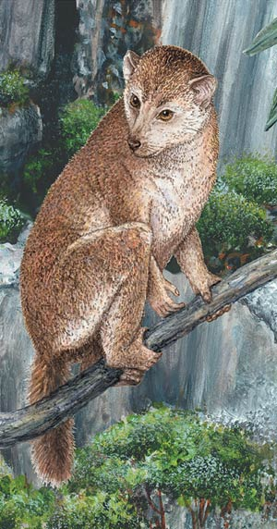
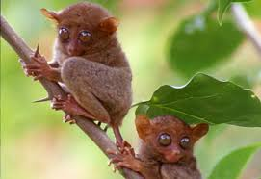
Prosimii to Hominoid Evolution
In the Eocene epoch, Prosimians specially the lemurs, lorises and tarsiers became abundant. They were distributed mostly in north America, Europe and Asia (china).
However, the small Prosimians gradually reduced to a few varieties and reached almost at the verge extinction especially in Europe and America by the end of Eocene epoch.
In the old world, many higher primates evolved from Prosimians but Prosimians themselves could not win in competition. So the number of genera diminished gradually and at present only a few representatives of the family Adapidae and Tarsidae are found alive.

Slide 12
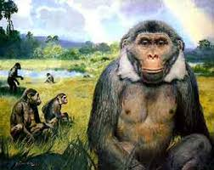
The succeeding epoch Oligocene records an important development of primate. But, unfortunately the number of fossils obtained from Oligocene level are quite limited only from Africa especially Fayum in Egypt.
However, the Egyptian primates comprised of a variety like Parapithecus, Propliopithecus, Mocropithecus, Oligopithecus, Aeolopithecus, Aegyptopithecus and so on.
Among these, Parapithecus has been ascribed as a likely ancestor of all present day monkeys- new world and old world .

Slide 13
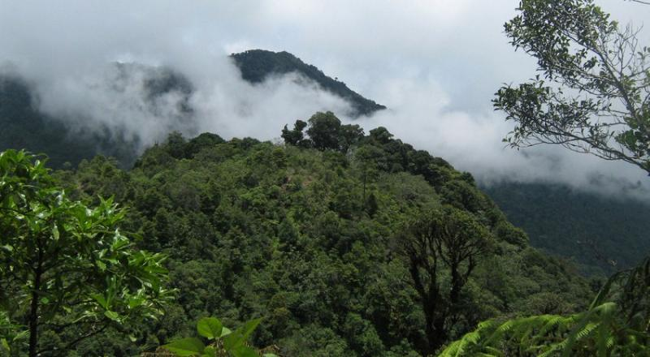
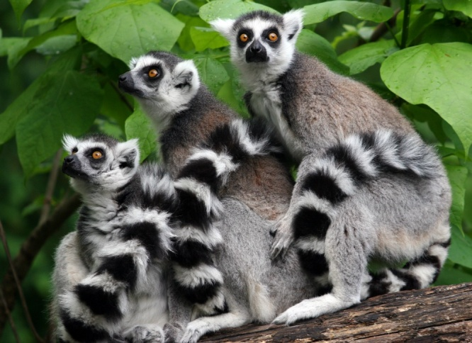
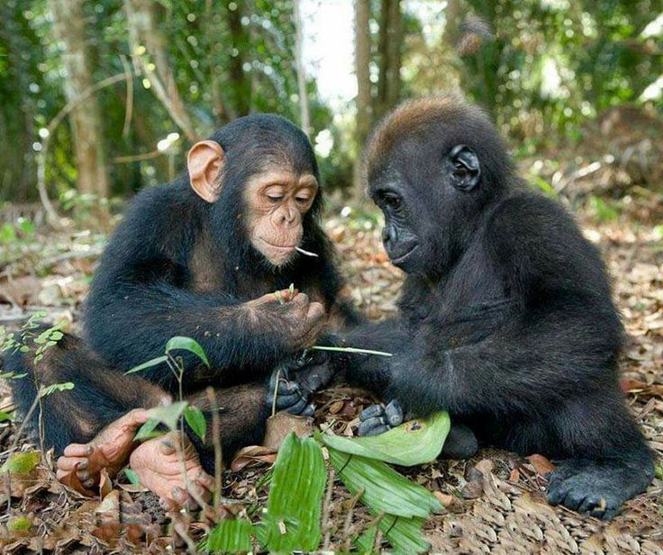
In case of Parapithecus, this creature is the most primitive form of all known old world monkeys and apes. It holds an intermediate position between Prosimian (Tarsoid, lemuroid) and Anthropoid. Propliopithecus ranks next to it whose jaws and teeth resemble much with the higher primates especially the Gibbon. Aeolopithecus also shows a close resemblance to the modern Gibbon.

Slide 14
However, it seems that Oligocene offers a critical turning point, primate line has been bifurcated from this time—one became ancestral to the monkey and other to the apes. All Oligocene primates have therefore been categorized under the sub-order ‘Anthropoidea’, some of who finally went towards ‘Hominoidea’.
Oligocene Primate
Anthropoidea
Monkey
Hominoidea

Slide 15
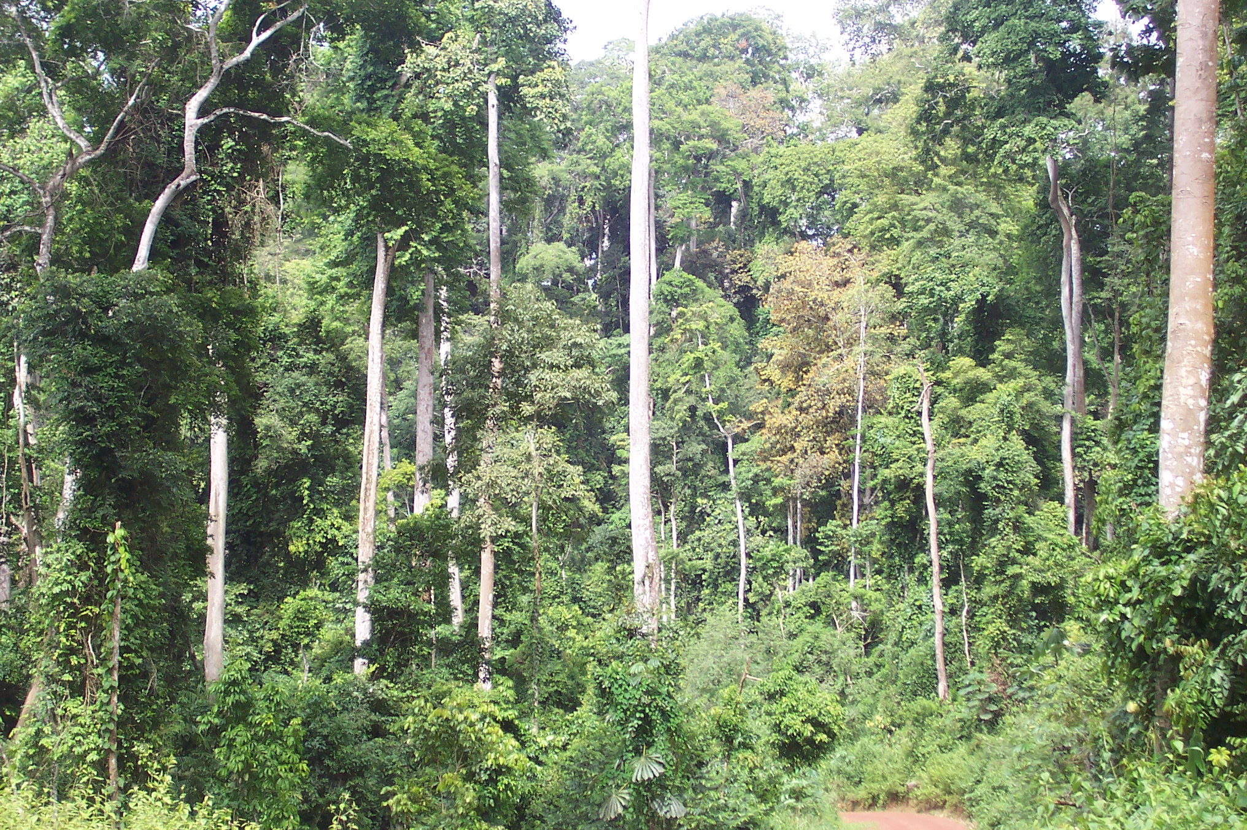
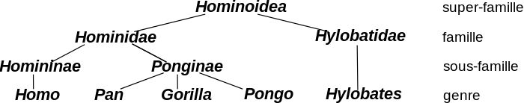
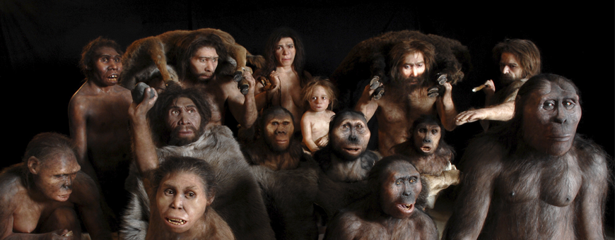

Slide 16
Hominoid to Hominid
The hominoid stage is more akin to man but man himself belong to the hominid stage. The whole ape-group has been covered by the term ‘hominoid’.
In considering the evolution of apes, we should begin with the Dryopithecine group of primates. However, Dryopithecus falls under the family Hominidae and family Hylobatidae comprising with Gibbon, Siamang and family Pongidae comprising with Orangutan, Bonobo, Gorilla, Chimpanzee.
Anthropoidea
Platyrrhine
Catarrhine
Hylobatidae
Pongidae
Hominidae

Slide 17
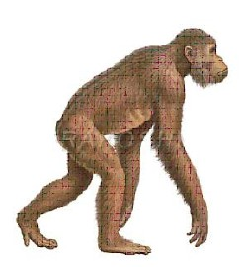
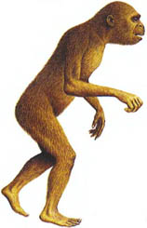
In fact, the Dryopithecus variety grouped under Pongidae in course of time gave rise to the apes today.
On the other hand, Ramapithecus belonging to the family Hominidae is said to be in the direct line of man though it is not an immediate ancestor.
Pongidae
Dryopithecus
Hominidae
Ramapithecus

Slide 18
Stage of Australopithecines:
Australopithecines are placing under a sub-family of hominidae because it is definite that our ancestors maintained a close similarity with some of members of this group. As regard their relation to human phylogeny, fossil of genus
Australopithecus are now fully recognized to be the earliest clear and undoubted hominids and hence probable ancestors of modern man. Paleoanthropologists greatly differ from the Dryopihecinae and the existing apes and approach the human condition chiefly in their dental and cerebral characters. In view of this fact they considered to be on the direct human line or close to its separation from the apes lineage.
Living Apes
Hominidae
Australopithecines
Human

Slide 19
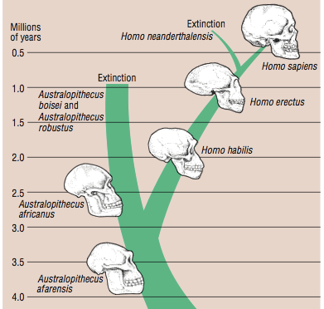
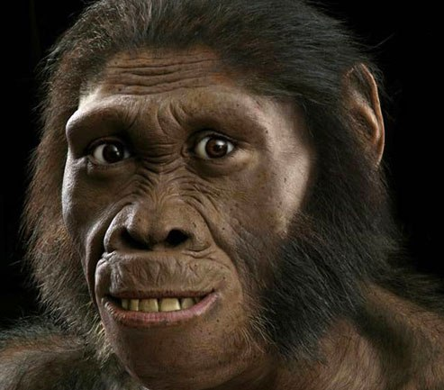
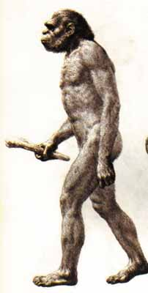

Slide 20
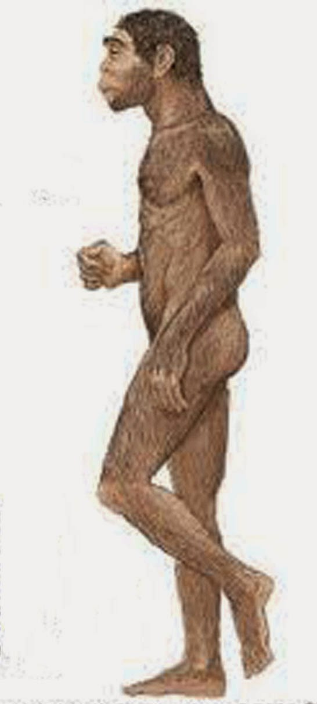
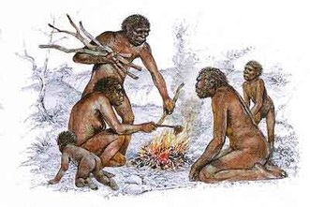
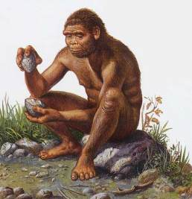
Hominid to Homo
The earliest members of the genus Homo are of particular significance as they mark the evolution of our own species. Australopithecus had a brain considerably below the range found in humans. It is not clearly known if he made stone tools in the strict sense of the term. Thus, no doubt he was the hominid yet not human and hence may be termed as pre-human hominid.
Homo erectus was a true human as he exhibited all the basic elements of the human bio-cultural adaptive pattern.

Slide 21
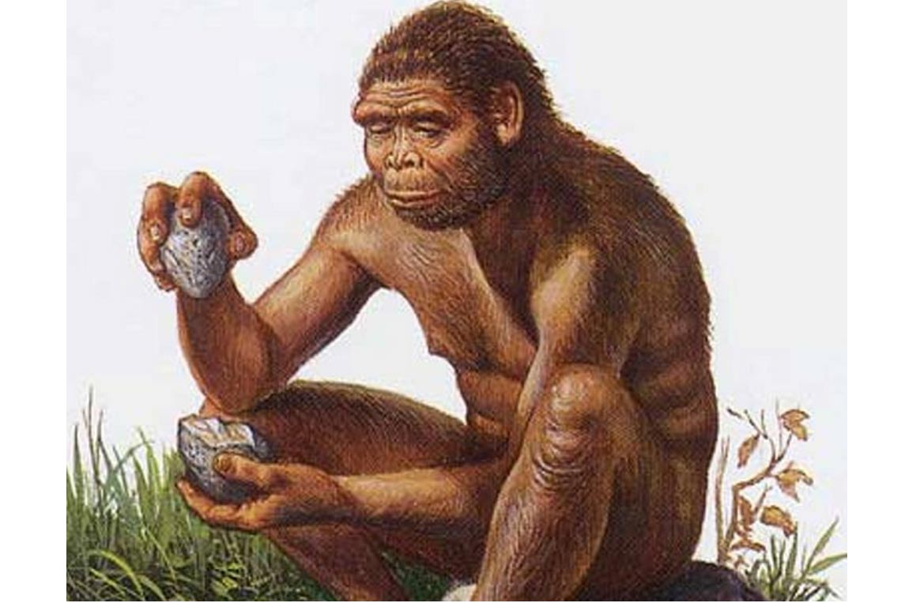
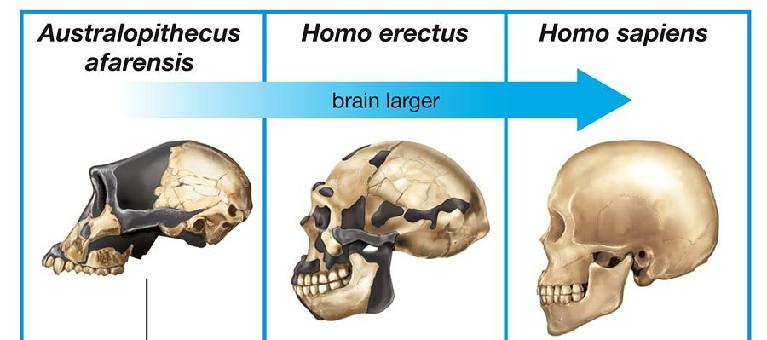
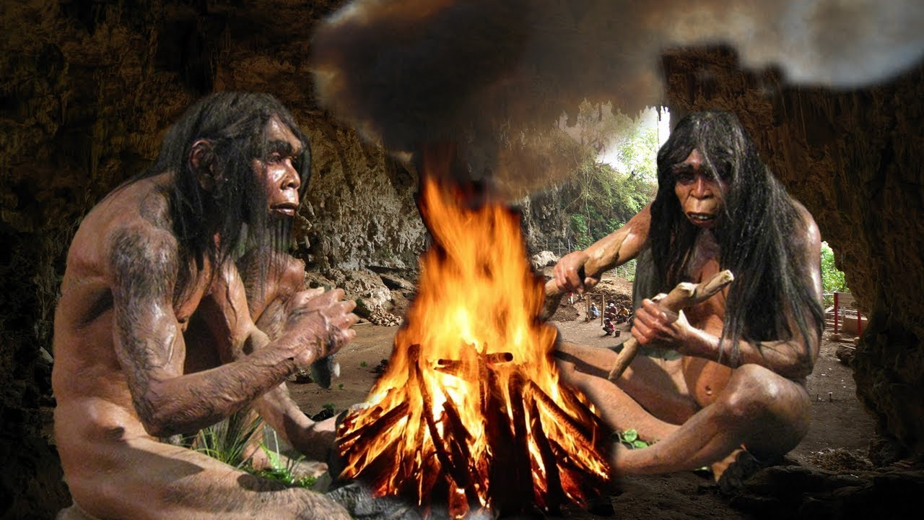
Stage of Homo erectus:
The next stage to Australopithecus is the stage of homo erectus. Homo erectus have been considered true human because they exhibit expanded cranial capacity and possibly human behavioural characteristics like they used fire, made stone tools and other implements, used the clean skin of other animals and therefore may be taken to represent the beginning of true man.
The fossil remains of homo erectus, particularly from java, peking and east Africa demonstrate that the range of variation of many features falls within that of modern homo sapiens.

Slide 22
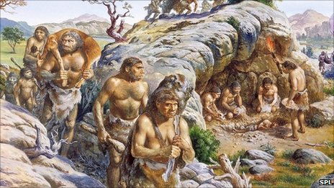
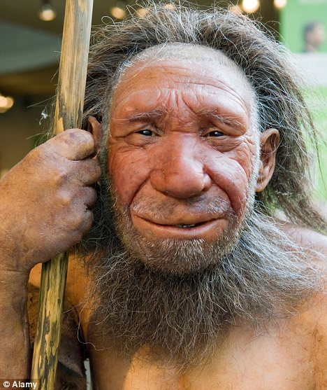
Stages of Homo Neanderthal:
The third stage has been represented by the homo Neanderthals—an intermediate type between homo erectus and modern man.

Slide 23
But, in fact the modern man can not the descendant of Neanderthal on two grounds:
The completely evolved modern type of fossil men have been discovered in western Europe from the layers earlier than those containing Neanderthal remains.
No evolutionary change has been noticed among the Neanderthals with the passage of time. Even the progressive Neanderthals do not show any transition towards the modern man.
Most of the paleoanthropologists consider the progressive Neanderthals (e.g. karpina, steinheim, eringsdorf, mount carmel etc.) collateral or cousin of the ancestors of
Cro-magnon type.
Therefore, in no case the Neanderthals can be the direct ancestors of modern man. They were readily replaced by the onslaught of more progressive new-comers
Cro-magnon or other similar type of population.

Slide 24
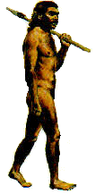
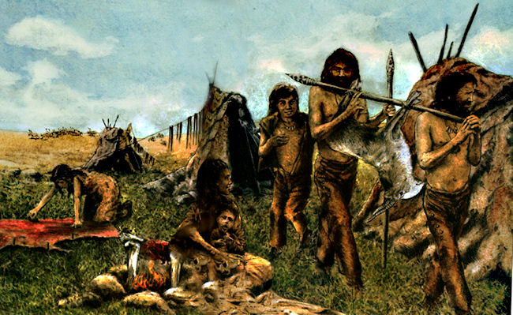
The Cro-magonon of late Pleistocene was believed to be the earliest type of homo sapiens for long time. But when a few other fossil remain exhibiting many characteristics of homo sapiens (like swanscombe man, London skull, boskop skull, fontechevade skull etc.) were discovered from the earlier layers than those of Cro-magnons and even the Neanderthals, the whole model of evolution became defunct.

Slide 25
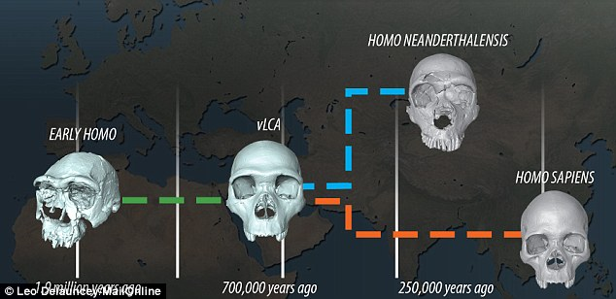
The fact suggest a parallel development of homo sapiens and Neanderthal; the newly discovered fossils from middle Pleistocene deposit are therefore the earliest form of homo sapiens. Upper or late pliestocene men have been considered as Neanthropic men who exhibited a wide diversity of forms like grimaldi man, cro-magnon man, chancelade man and so on.

Slide 26
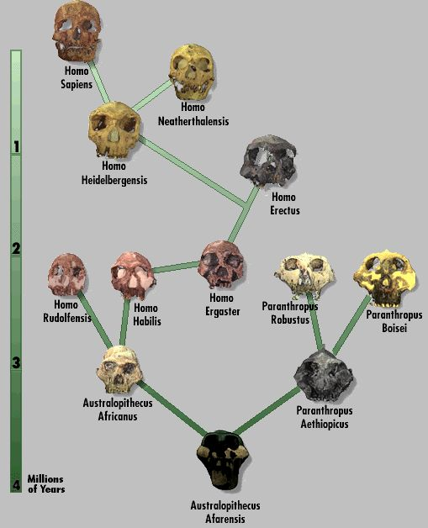
It is therefore very clear that the anthropoid apes, pre-hominids and modern man, all originated from a common ancestral stock. To trace the antiquity of man we have no alternative other than to study primates particularly the stages between prosimii to hominoid that have been unveiled through several fossil forms.

Slide 27
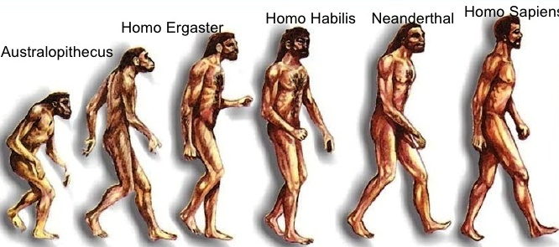
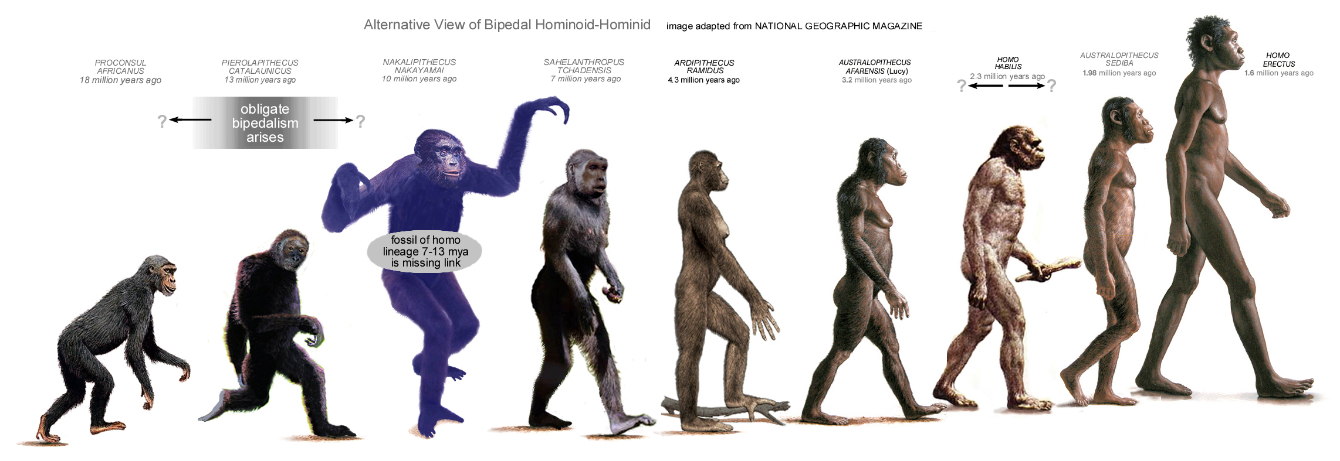
Final Stages of Human Evolution

Slide 28

Prepared by: Mohan Chandra Dolai

